Slide 1
Lecture 17: Graph Traversal and Topological Sort
Keren Zhu
kerenzhu@cse.cuhk.edu.hk

Slide 2
Announcement
Quiz 2 on April 15 in class
HW 8 is posted and is due on April 23
No late submission this time

Slide 3
Graph traversal
Graph traversal is very similar to tree traversal
The difference is that we need to record whether a vertex is visited and we need to visit all unvisited vertices
Traversals of graphs are also called searches

Slide 4
Strategies
We can use either breadth-first or depth-first traversals
Breadth-first requires a queue
Depth-first requires a stack
We each case, we will have to track which vertices have been visited requiring Θ(|V|) memory
One option is a hash table
If we can use a bit array, this requires only |V|/8 bytes
The time complexity cannot be better than and should not be worse than Θ(|V| + |E|)
Connected graphs simplify this to Θ(|E|)
Worst case: Θ(|V^{|2})

Slide 5
Breadth-first traversal
Consider implementing a breadth-first traversal on a graph:
Choose any vertex, mark it as visited and push it onto queue
While the queue is not empty:
Pop to top vertex v from the queue
For each vertex adjacent to v that has not been visited:
Mark it visited, and
Push it onto the queue
This continues until the queue is empty
Note: if there are no unvisited vertices, the graph is connected,

Slide 6
Depth-first traversal
Consider implementing a depth-first traversal on a graph:
Choose any vertex, mark it as visited
From that vertex:
If there is another adjacent vertex not yet visited, go to it
Otherwise, go back to the most previous vertex that has not yet had all of its adjacent vertices visited and continue from there
Continue until no visited vertices have unvisited adjacent vertices
Two implementations:
Recursive
Iterative

Slide 7
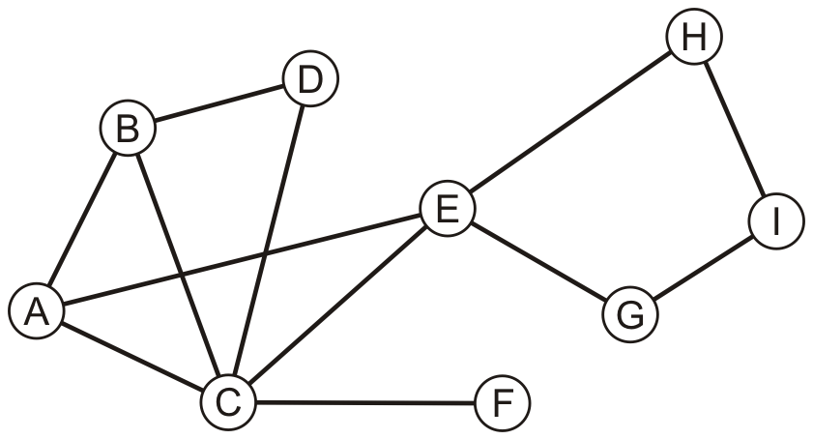
Example
Consider this graph

Slide 8
Example
Performing a breadth-first traversal
Push the first vertex onto the queue
A

Slide 9
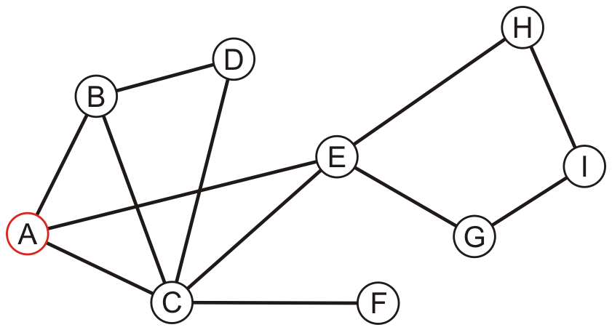
Example
Performing a breadth-first traversal
Pop A and push B, C and E
A
B | C | E

Slide 10
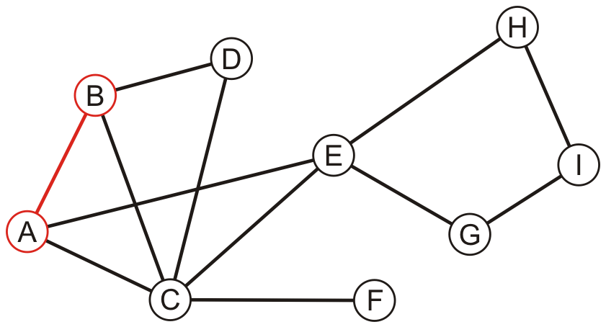
Example
Performing a breadth-first traversal:
Pop B and push D
A, B
C | E | D

Slide 11
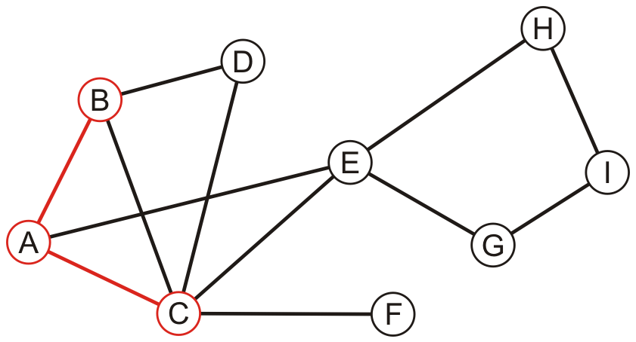
Example
Performing a breadth-first traversal:
Pop C and push F
A, B, C
E | D | F

Slide 12
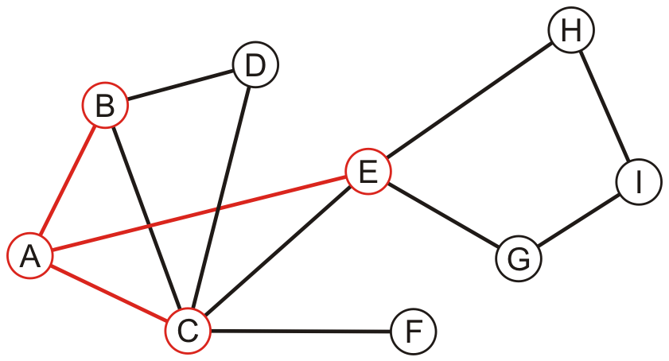
Example
Performing a breadth-first traversal:
Pop E and push G and H
A, B, C, E
D | F | G | H

Slide 13
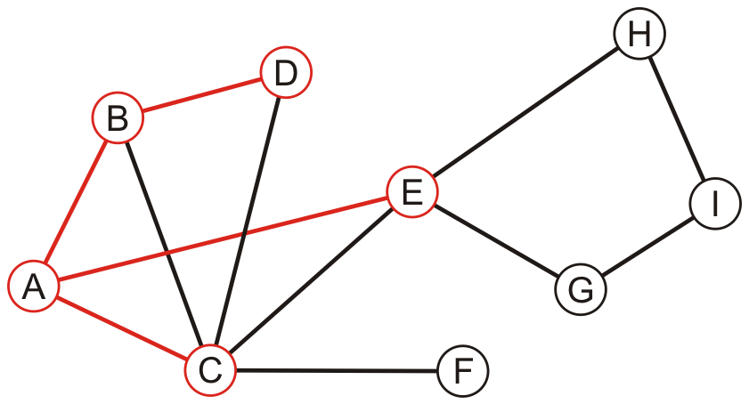
Example
Performing a breadth-first traversal:
Pop D
A, B, C, E, D
F | G | H

Slide 14
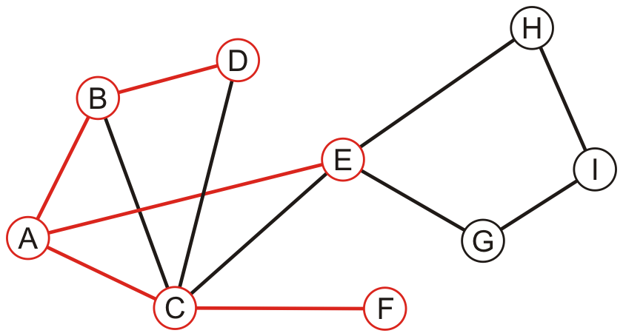
Example
Performing a breadth-first traversal:
Pop F
A, B, C, E, D, F
G | H

Slide 15
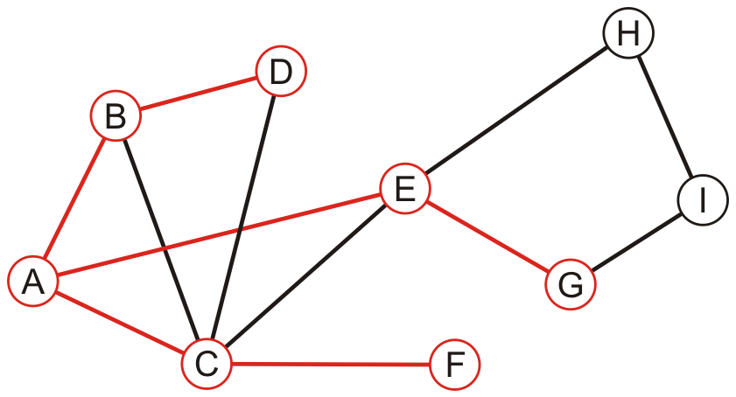
Example
Performing a breadth-first traversal:
Pop G and push I
A, B, C, E, D, F, G
H | I

Slide 16
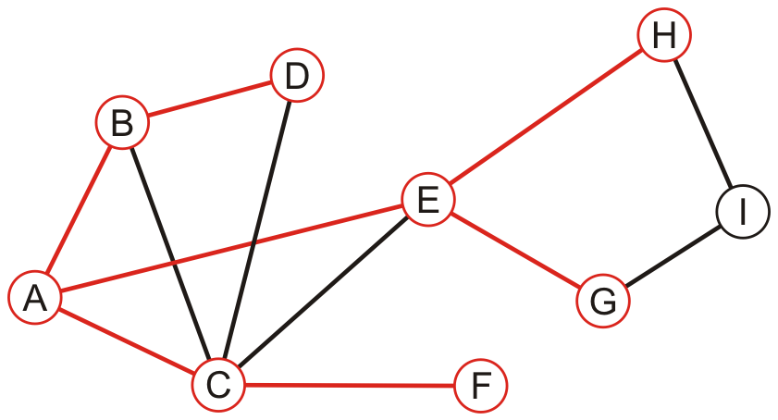
Example
Performing a breadth-first traversal:
Pop H
A, B, C, E, D, F, G, H
I

Slide 17
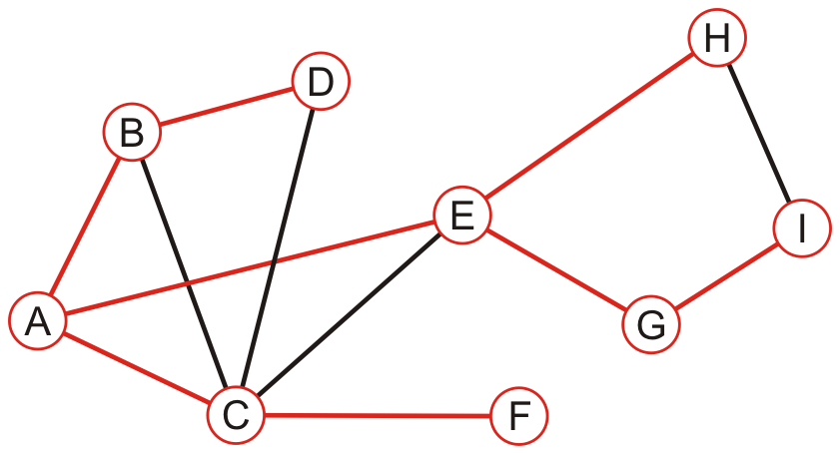
Example
Performing a breadth-first traversal:
Pop I
A, B, C, E, D, F, G, H, I

Slide 18
Example
Performing a breadth-first traversal:
The queue is empty: we are finished
A, B, C, E, D, F, G, H, I

Slide 19
Example
Perform a recursive depth-first traversal on this same graph

Slide 20
Example
Performing a recursive depth-first traversal:
Visit the first node
A

Slide 21
Example
Performing a recursive depth-first traversal:
A has an unvisited neighbor
A, B

Slide 22
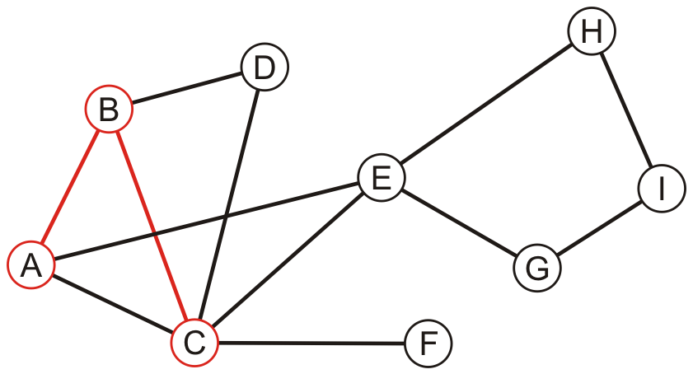
Example
Performing a recursive depth-first traversal:
B has an unvisited neighbor
A, B, C

Slide 23
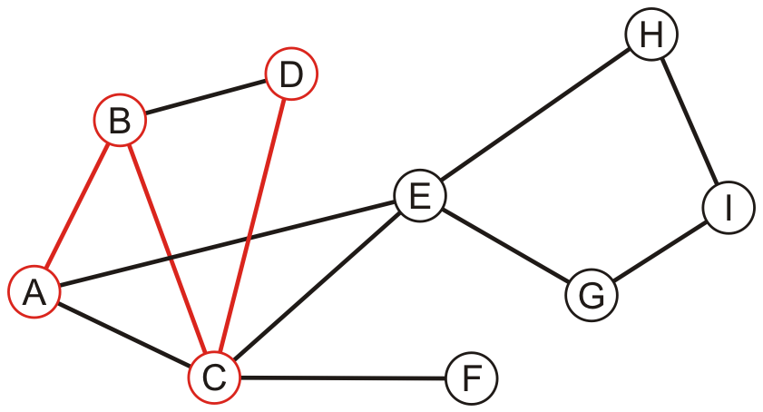
Example
Performing a recursive depth-first traversal:
C has an unvisited neighbor
A, B, C, D

Slide 24
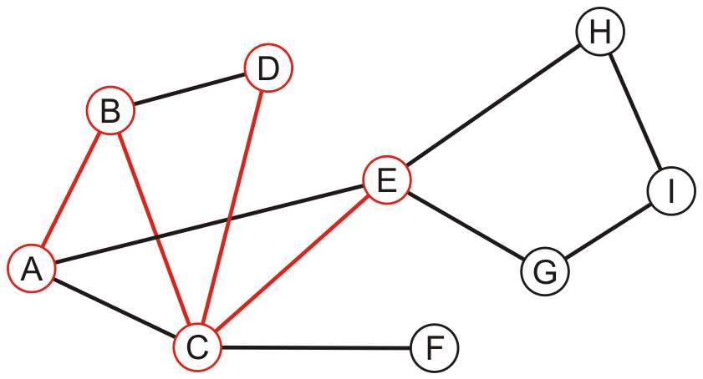
Example
Performing a recursive depth-first traversal:
D has no unvisited neighbors, so we return to C
A, B, C, D, E

Slide 25
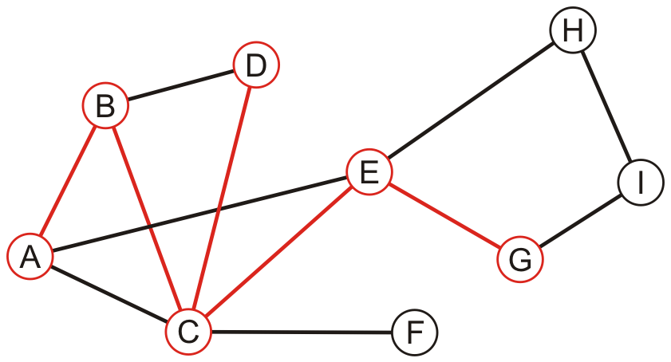
Example
Performing a recursive depth-first traversal:
E has an unvisited neighbor
A, B, C, D, E, G

Slide 26
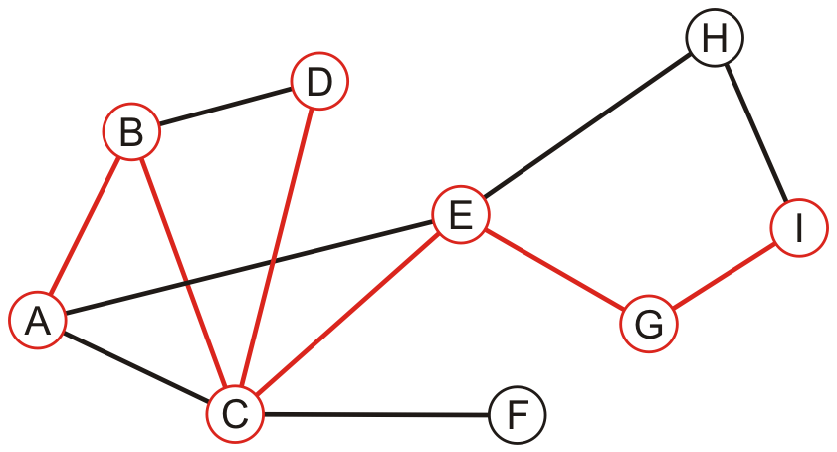
Example
Performing a recursive depth-first traversal:
F has an unvisited neighbor
A, B, C, D, E, G, I

Slide 27
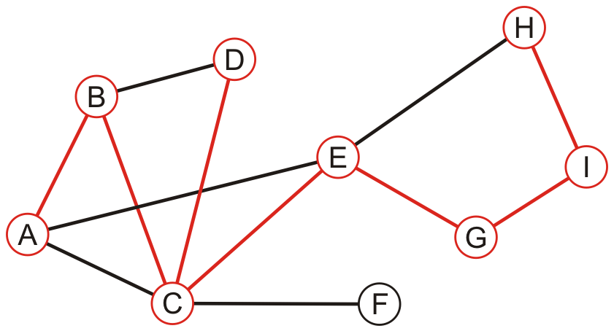
Example
Performing a recursive depth-first traversal:
H has an unvisited neighbor
A, B, C, D, E, G, I, H

Slide 28
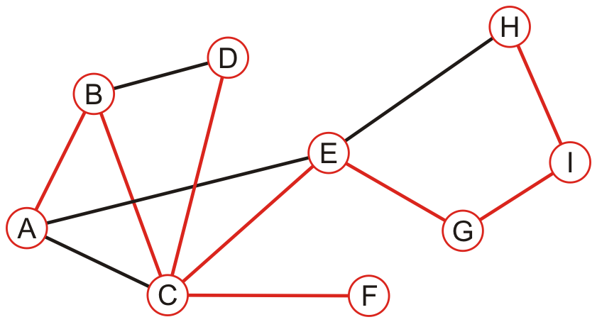
Example
Performing a recursive depth-first traversal:
We recurse back to C which has an unvisited neighbour
A, B, C, D, E, G, I, H, F

Slide 29
Example
Performing a recursive depth-first traversal:
We recurse finding that no other nodes have unvisited neighbours
A, B, C, D, E, G, I, H, F

Slide 30
Comparison
Performing a recursive depth-first traversal:
We recurse finding that no other nodes have unvisited neighbours
A, B, C, D, E, G, I, H, F

Slide 31
Comparison
The order in which vertices can differ greatly
An iterative depth-first traversal may also be different again
A, B, C, E, D, F, G, H, I
A, B, C, D, E, G, I, H, F

Slide 32
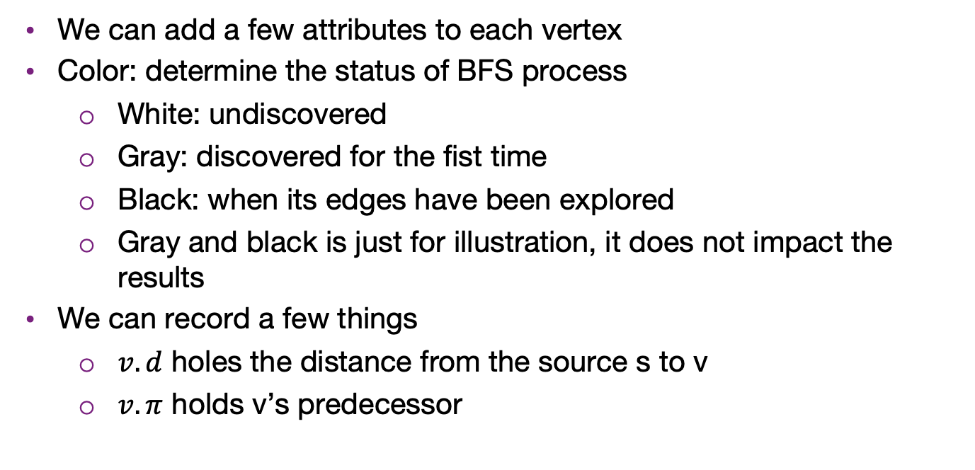
CLRS BFS procedures
We can add a few attributes to each vertex
Color: determine the status of BFS process
White: undiscovered
Gray: discovered for the fist time
Black: when its edges have been explored
Gray and black is just for illustration, it does not impact the results
We can record a few things
$v.d$ holes the distance from the source s to v
$v.π$ holds v’s predecessor

Slide 33
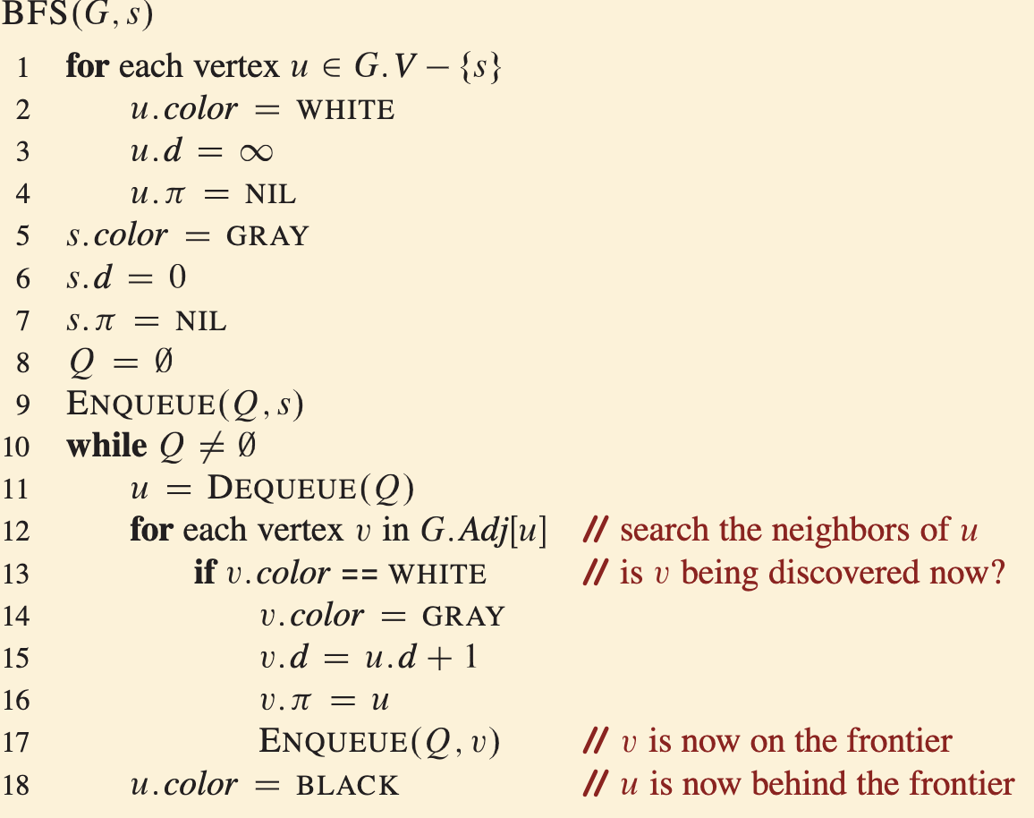
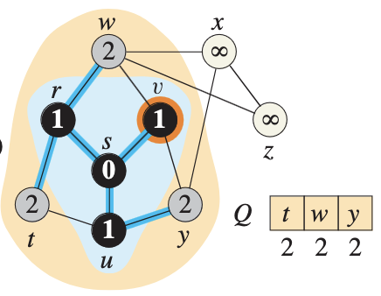
CLRS BFS procedures
Basically the same as our previous illustration

Slide 34
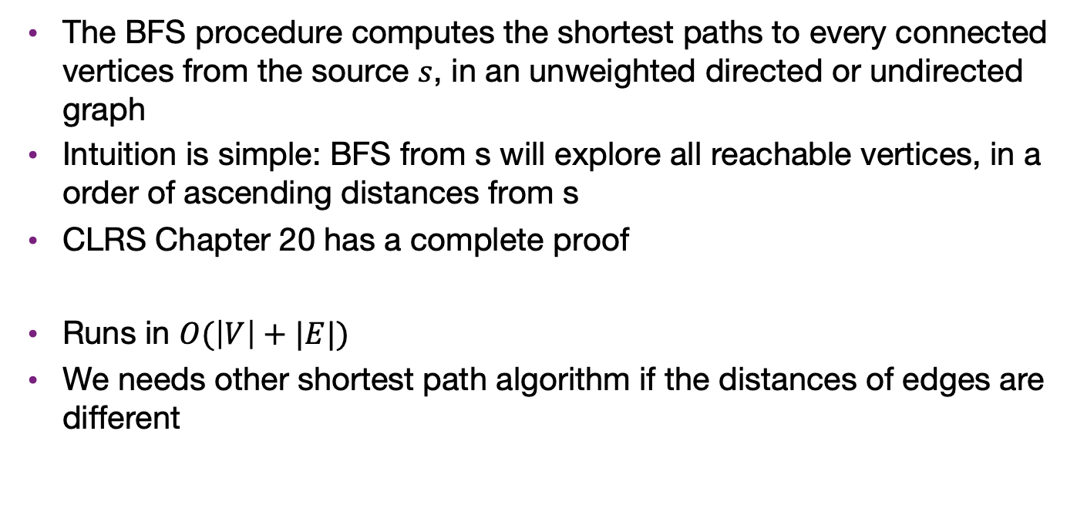
BFS and shortest path
The BFS procedure computes the shortest paths to every connected vertices from the source $s$, in an unweighted directed or undirected graph
Intuition is simple: BFS from s will explore all reachable vertices, in a order of ascending distances from s
CLRS Chapter 20 has a complete proof
Runs in $O(\left|V\right|+|E|)$
We needs other shortest path algorithm if the distances of edges are different

Slide 35
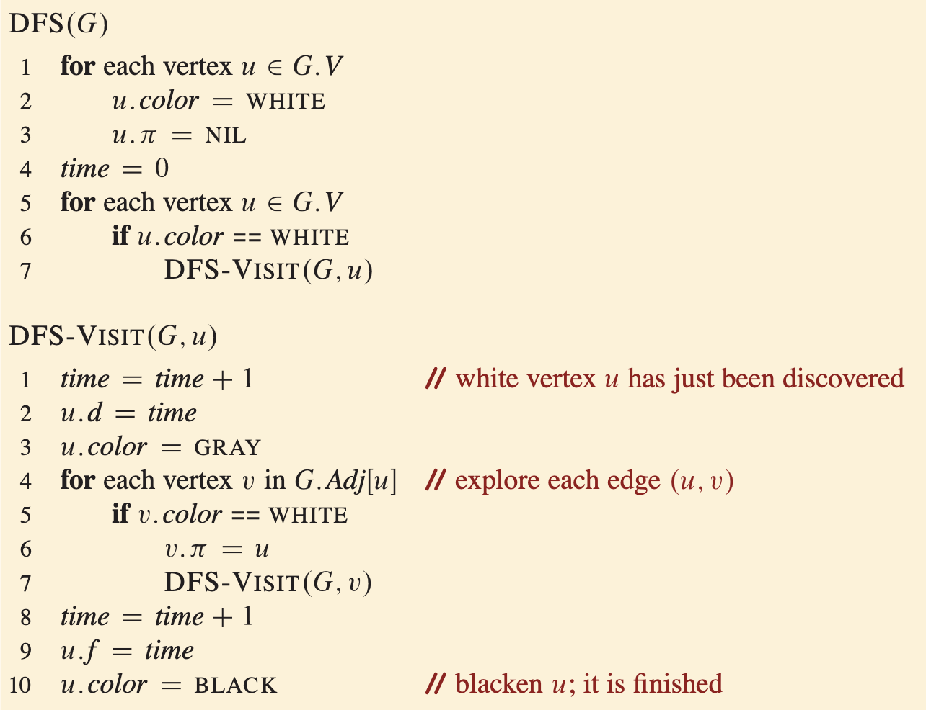
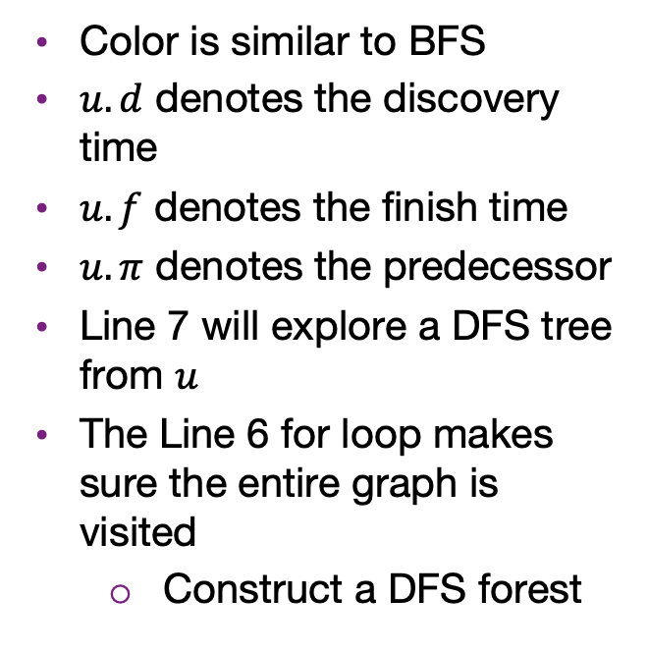
CLRS DFS algorithm
Color is similar to BFS
$u.d$ denotes the discovery time
$u.f$ denotes the finish time
$u.π$ denotes the predecessor
Line 7 will explore a DFS tree from $u$
The Line 6 for loop makes sure the entire graph is visited
Construct a DFS forest

Slide 36
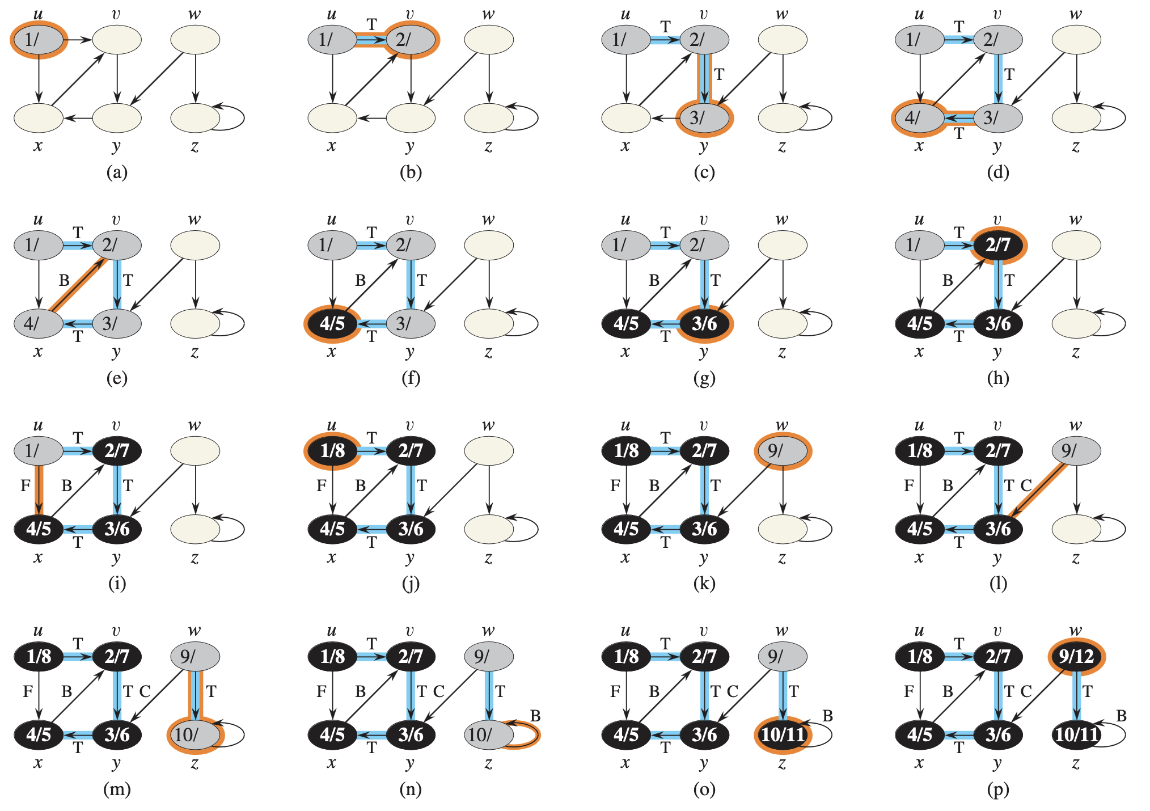
T: tree
B: back
F: forward
C: cross

Slide 37

Runtime
The procedure DFS-VISIT is called exactly once for each vertex,
During an execution of DFS-VISIT, the loop in lines 4-7 executes $|Adj[v]|$ times
$\sum_{v∈V}{\left|Adj\left[v\right]\right|=Θ(E)}$
Lines 1-3 and 5-7 of DFS
takes $Θ(V)$
Summing up takes $Θ(V+E)$

Slide 38
Cycle theorem
Let T be an arbitrary DFS forest. G contains a cycle if and only if there is a back edge in T

Slide 39
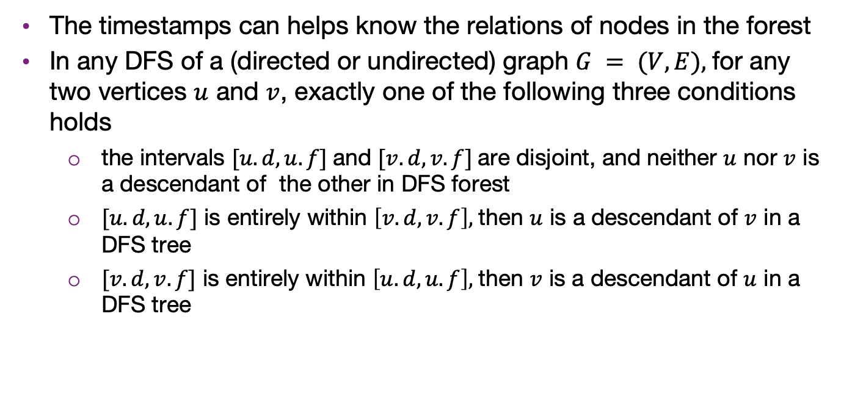
Parenthesis theorem
The timestamps can helps know the relations of nodes in the forest
In any DFS of a (directed or undirected) graph $G = (V, E),$for any two vertices $u$ and $v$, exactly one of the following three conditions holds
the intervals $[u.d, u.f]$and $[v.d, v.f]$are disjoint, and neither $u$ nor $v$ is a descendant of the other in DFS forest
$[u.d, u.f]$ is entirely within $\left[v.d, v.f\right],$then $u$ is a descendant of $v$ in a DFS tree
$[v.d, v.f]$ is entirely within $\left[u.d, u.f\right],$then $v$ is a descendant of $u$ in a DFS tree

Slide 40

White-path theorem
In a DFS forest, vertex $v$ is a descendant of vertex $u$ if and only if at the time $u.d$that the search discovers $u$, there is a path from $u$to $v$ consisting of entirely of white vertices.
Example:

Slide 41
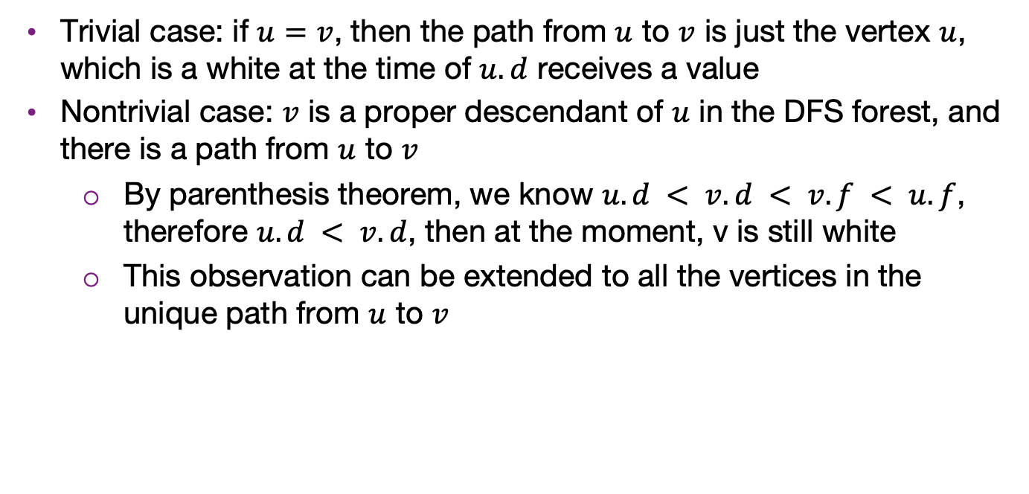
Proof of $→$
Trivial case: if $u=v$, then the path from $u$ to $v$ is just the vertex $u$, which is a white at the time of $u.d$ receives a value
Nontrivial case: $v$ is a proper descendant of $u$ in the DFS forest, and there is a path from $u$ to $v$
By parenthesis theorem, we know $u.d < v.d < v.f < u.f$, therefore $u.d < v.d$, then at the moment, v is still white
This observation can be extended to all the vertices in the unique path from $u$ to $v$

Slide 42

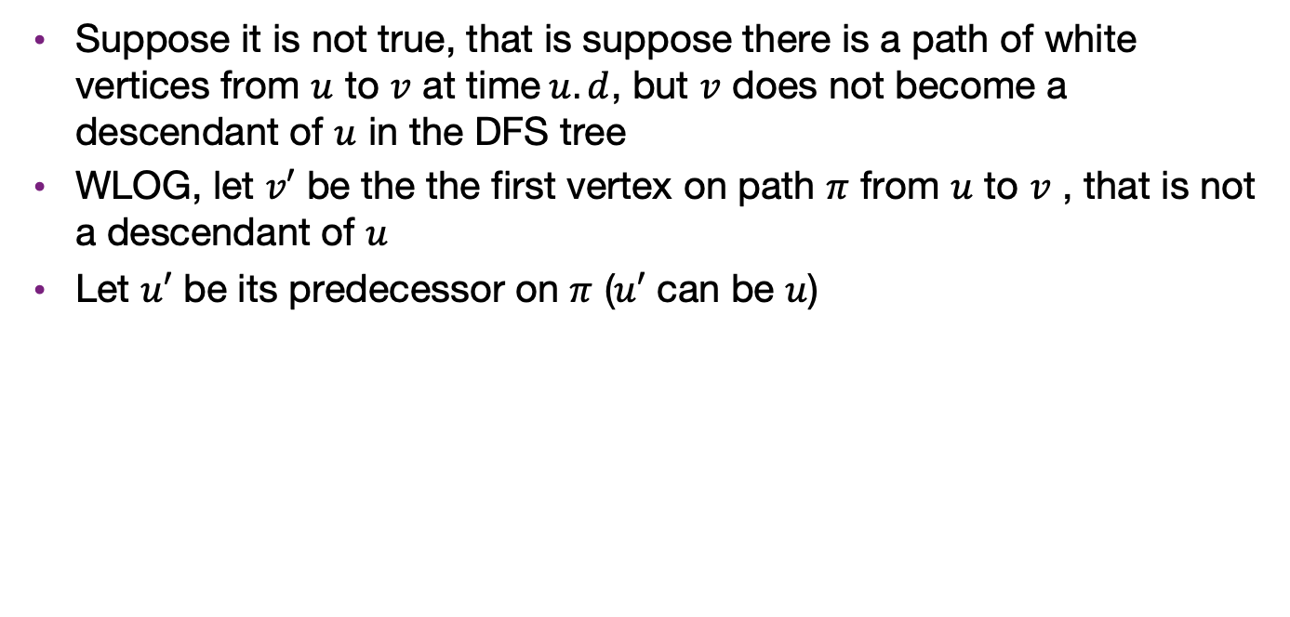
Proof of $←$
Suppose it is not true, that is suppose there is a path of white vertices from $u$ to $v$ at time$u.d$, but $v$ does not become a descendant of $u$ in the DFS tree
WLOG, let $v′$ be the the first vertex on path $π$ from $u$ to $v$ , that is not a descendant of $u$
Let $u′$ be its predecessor on $π$ ($u′$ can be $u$)

Slide 43
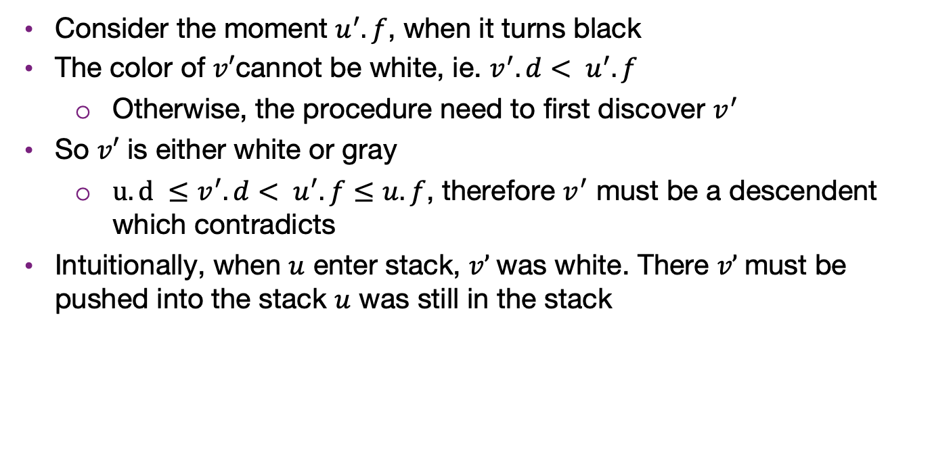
Proof of $←$
Consider the moment $u^{′}.f$, when it turns black
The color of $v′$cannot be white, ie. ${v^{′}.d< u}^{′}.f$
Otherwise, the procedure need to first discover $v^{′}$
So $v′$ is either white or gray
$u.d ≤{v^{′}.d< u}^{′}.f≤u.f$, therefore $v^{′}$ must be a descendent which contradicts
Intuitionally, when $u$ enter stack, $v’$was white. There $v’$must be pushed into the stack $u$ was still in the stack

Slide 44
Topological sort and DAG
A a directed acyclic graph (DAG)
is directed
does not contain cycle
In many application, we hope our graph has no cycle
A graph representing pre-requisite of courses
A dependent task graph

Slide 45
Restriction of paths in DAGs
In a DAG, given two different vertices v_{j} and v_{k}, there cannot both be a path from v_{j} to v_{k} and a path from v_{k} to v_{j}
Proof:
Assume otherwise; thus there exists two paths:
(v_{j}, v_{1,1}, v_{1,2} , v_{1,3} , … , v_{k})
(v_{k}, v_{2,1}, v_{2,2} , v_{2,3} , … , v_{j})
From this, we can construct the path
(v_{j}, v_{1,1}, v_{1,2} , v_{1,3} , … , v_{k}, v_{2,1}, v_{2,2} , v_{2,3} , … , v_{j})
This a path is a cycle, but this is an acyclic graph
∴ contradiction

Slide 46
Definition of topological sorting
A topological sorting of the vertices in a DAG is an ordering
v₁, v₂, v₃, …, v_{|V|}
such that v_{j} appears before v_{k} if there is a path from v_{j} to v_{k}

Slide 47
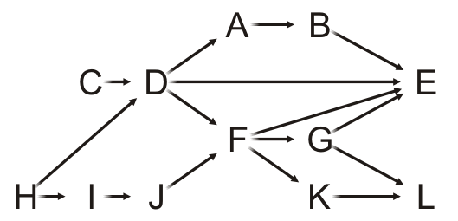
Definition of topological sorting
Given this DAG, a topological sort is
H, C, I, D, J, A, F, B, G, K, E, L

Slide 48
Example
For example, there are paths from H, C, I, D and J to F, so all these must come before F in a topological sort
H, C, I, D, J, A, F, B, G, K, E, L
Clearly, this sorting need not be unique

Slide 49
Applications
Consider the course instructor getting ready for a dinner out
He must wear the following:
jacket, shirt, briefs, socks, tie, etc.
There are certain constraints:
the pants really should go on after the briefs,
socks are put on before shoes

Slide 50
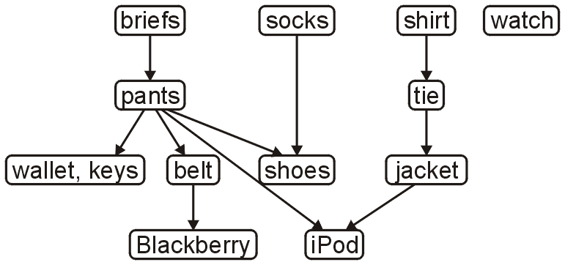
Applications
The following is a task graph for getting dressed:
One topological sort is:
briefs, pants, wallet, keys, belt, socks, shoes, shirt, tie, jacket, iPod, watch
A more reasonable topological sort is:
briefs, socks, pants, shirt, belt, tie, jacket, wallet, keys, iPod, watch, shoes

Slide 51
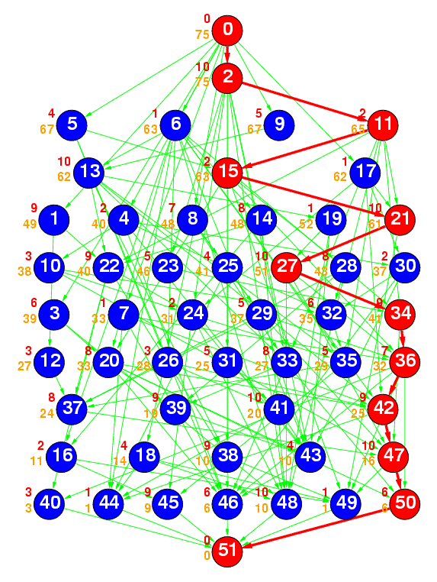
Applications
Ref: The Standard Task Graph
http://www.kasahara.elec.waseda.ac.jp/schedule/
The following is a DAG
representing a number of tasks
The green arrows represent dependencies
The numbering indicates a topological sort of the tasks

Slide 52
Topological Sort
Theorem:
A graph is a DAG if and only if it has a topological sorting
Proof strategy:
Such a statement is of the form a ↔ b and this is equivalent to:
a → b and b → a

Slide 53
Topological Sort
First, we need a two lemmas:
A DAG always has at least one vertex with in-degree zero
That is, it has at least one source
Proof:
If we cannot find a vertex with in-degree zero, we will show there must be a cycle
Start with any vertex and define a list L = (v)
Then iterate this loop |V| times:
Given the list L, the first vertex ℓ₁ does not have in-degree zero
Find any vertex w such that (w, ℓ₁) is an edge
Create a new list L = (w, ℓ₁, …, ℓ_{k})
By the pigeon-hole principle, at least one vertex must appear twice
This forms a cycle; hence a contradiction, as this is a DAG

Slide 54
Topological Sort
First, we need a two lemmas:
Any sub-graph of a DAG is a DAG
Proof:
If a sub-graph has a cycle, that same cycle must appear in the super-graph
We assumed the super-graph was a DAG
This is a contradiction

Slide 55
Proof of lemma 1
We will start with showing a → b:
If a graph is a DAG, it has a topological sort
By induction:
A graph with one vertex is a DAG and it has a topological sort
Assume a DAG with n vertices has a topological sort
A DAG with n + 1 vertices must have at least one vertex v of in-degree zero

Slide 56
Proof of lemma 1
Continue on induction:
Removing the vertex v and consider the vertex-induced sub-graph with the remaining n vertices
If this sub-graph has a cycle, so would the original graph—contradiction
Thus, the graph with n vertices is also a DAG, therefore it has a topological sort
Add the vertex v to the start of the topological sort to get one for the graph of size n + 1
Another way to prove is to write a procedure to generate topologic sort

Slide 57
Proof of lemma 2
Next, we will show that b → a: If a graph has a topological ordering, it must be a DAG
We will show this by showing the contrapositive: ¬a → ¬b:
If a graph is not a DAG, it does not have a topological sort
By definition, it has a cycle: (v₁, v₂, v₃, …, v_{k}, v₁)
In any topological sort, v₁ must appear before v₂, because (v₁, v₂) is a path
However, there is also a path from v₂ to v₁: (v₂, v₃, …, v_{k}, v₁)
Therefore, v₂ must appear in the topological sort before v₁
Contradiction, therefore b → a
With the two lemmas, we have the theorem:
A graph is a DAG iff it has a topological sort

Slide 58
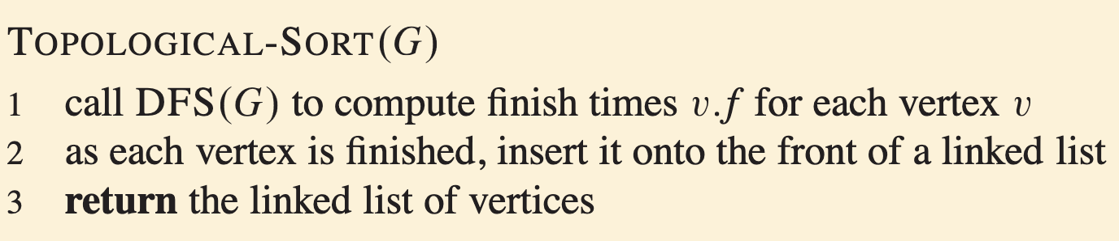

Topological sort procedure
Using DFS can easily produce a topological sort of a graph
Runs in $Θ(V+E)$, same as DFS asymtopically
But the question is how can we say it is correct

Slide 59
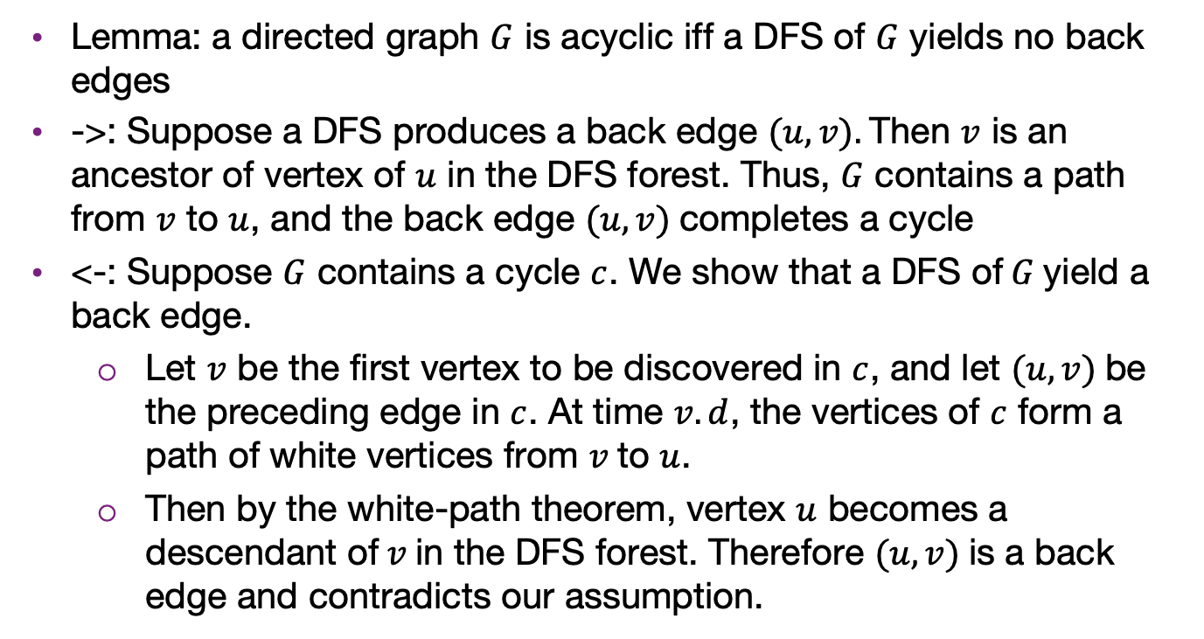
Proof topological-sort correctness
Lemma: a directed graph $G$ is acyclic iff a DFS of $G$ yields no back edges
->: Suppose a DFS produces a back edge $(u, v).$Then $v$ is an ancestor of vertex of $u$ in the DFS forest. Thus, $G$ contains a path from $v$ to $u$, and the back edge $(u, v)$completes a cycle
<-: Suppose $G$ contains a cycle $c$. We show that a DFS of$G$yield a back edge.
Let $v$ be the first vertex to be discovered in $c$, and let $(u, v)$be the preceding edge in $c$. At time $v.d$, the vertices of $c$ form a path of white vertices from $v$to $u$.
Then by the white-path theorem, vertex $u$ becomes a descendant of$v$in the DFS forest. Therefore $(u, v)$is a back edge and contradicts our assumption.

Slide 60
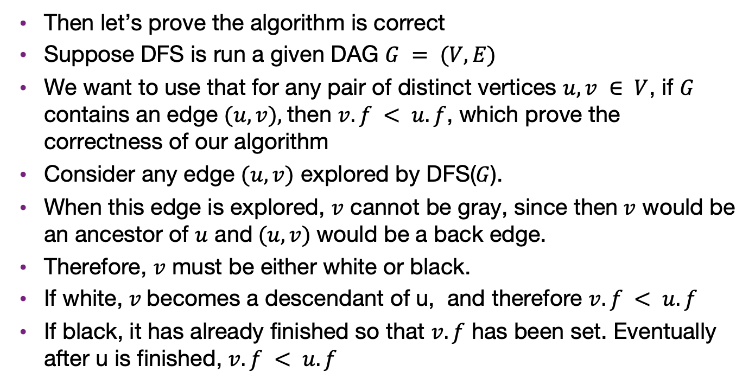
Proof topological-sort correctness
Then let’s prove the algorithm is correct
Suppose DFS is run a given DAG $G = (V, E)$
We want to use that for any pair of distinct vertices $u, v ∈ V$, if $G$ contains an edge $(u, v),$then $v.f < u.f$, which prove the correctness of our algorithm
Consider any edge $(u, v)$ explored by DFS($G$).
When this edge is explored, $v$ cannot be gray, since then$v$ would be an ancestor of $u$ and$(u, v)$would be a back edge.
Therefore, $v$ must be either white or black.
If white, $v$becomes a descendant of u, and therefore $v.f < u.f$
If black, it has already finished so that $v.f$ has been set. Eventually after u is finished, $v.f < u.f$

